Slide 1
HYPOPHARYNGEAL TUMOURS
Dr. Manoj Pandian S.P
Senior Resident
Department of ENT
Tagore Medical college Hospital

Slide 2
Anatomy of Hypopharynx
Superior limit- Plane passing from the body of hyoid bone to the Post pharyngeal wall
Inferior limit- Lower border of cricoid cartilage
Opposite C3-6 vertebra

Slide 3
Divisions of Hypopharynx
Pyriform sinus
Posterior Pharyngeal wall
Post cricoid region

Slide 4
Tumours of Hypopharynx
Benign (uncommon)
- Papilloma, adenoma, lipoma, fibroma & leiomyoma
- smooth, well defined mass ( pedunculated and mobile)

Slide 5
Tumours of Hypopharynx
Malignant ( Very common)
Mostly – Squamous cell carcinoma with varying grades of differentiation
Pyriform sinus
Post cricoid region
Posterior Pharyngeal wall

Slide 6
Ca pyriform sinus
60% of Hypopharyngeal Tumours
Males more than 40 years of age were most common
Growth- exophytic or ulcerative and deeply infiltrative
Asymptomatic for a long time due to large size of pyriform sinus
Metastatic neck nodes gets attention

Slide 7
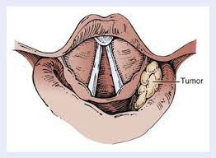

Slide 8
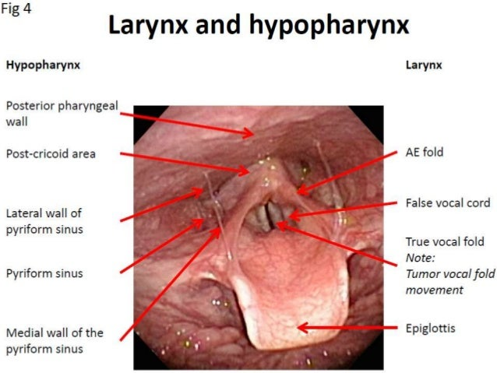
Ca Pyriform sinus spread
Local
Lymphatic
Distant metastases

Slide 9
Ca Pyriform sinus spread
Lymphatic- 75% have cervical lymph nodes at first visit (50% are bilateral)
Upper and mid jugular group of lymph nodes are commonly involved
Distant METASTASES - late
- Lung , liver & bones

Slide 10
Ca pyriform sinus- clinical features
Something sticking in the throat and “pricking sensation” on swallowing may be the earliest symptoms
Referred otalgia, pain on swallowing and increasing dysphagia
A mass of lymph nodes high up in the neck (upper and mid jugular) may be the first sign
Hoarseness and laryngeal obstruction (laryngeal spread)

Slide 11
Investigations
Indirect laryngoscopy
Pooling of saliva may obstruct the view
Barium swallow & CT neck
Endoscopic examination

Slide 12
treatment
Early growth with n0 - radiotherapy
Pyriform fossa without extension to post cricoid- total laryngectomy + partial pharyngectomy + elective neck dissection or prophylactic block dissection
Pyriform fossa with extension to post cricoid- total laryngectomy + pharyngectomy + Neck dissection + Pharyngocutaneous reconstruction with myocutaneous flaps or stomach pull up

Slide 13
Ca post cricoid
30% of laryngopharyngeal malignancies.
Plummer vinson syndrome or Patterson brown Kelly syndrome
Spread
Ulcerative type of lesion
Annular spread
Growths may invade cervicaloesophagus, arytenoids or recurrent laryngeal nerve
at cricoarytenoid joint.

Slide 14
Ca post cricoid spread
Lymphatic – paratracheal lymph nodes- bilateral due to midline nature of these lesions ( clinically palpable- no)

Slide 15
Ca post cricoid clinical features
Females in 20’s and 30’s
Progressive dysphagia is the predominant presenting symptom
progressive malnutrition and weight loss.
voice change and aphonia ( Laryngeal nerve involvement)

Slide 16
investigations
Oedema and erythema of the post cricoid region and pooling of secretions in the hypopharynx
Laryngeal crepitus may be absent
Lateral soft tissue radiograph of the neck- increased prevertebral shadow
Barium swallow
endoscopy

Slide 17
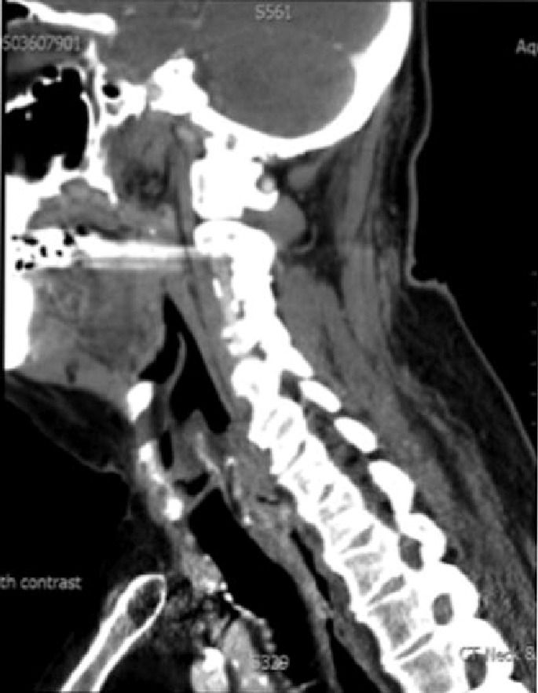
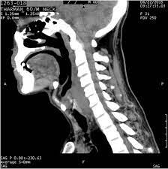

Slide 18
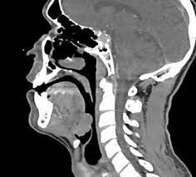

Slide 19
treatment
Poor prognosis with radiation and surgical treatment
RT Initially – preserves laryngeal function
If failed- laryngo-pharyngo- oesophagectomy + Stomach pull up or colon transposition

Slide 20
Ca post pharyngeal wall
10 % of hypopharyngeal tumor
Males > 50 years of age
Spread
exophytic or ulcerative
to the prevertebral fascia, muscles and vertebrae
Lymphatic spread is usually bilateral / retropharyngeal nodes may be involved

Slide 21
Ca post pharyngeal wall clinical features
Dysphagia or spitting of blood
palpable mass of nodes in the neck without any symptoms

Slide 22
investigations
Indirect laryngoscopy
Lateral soft tissue radiography
Endoscopy

Slide 23
treatment
Early lesions - radiotherapy or surgically via lateral pharyngotomy and primary repair
Advanced lesions- laryngopharyngectomy and block dissection of neck
5 year survival rate- 19%

Slide 24
https://radiopaedia.org/cases/5828738157959a44421642be1f01df04?lang=us

Slide 25
Thank you

